Slide 1

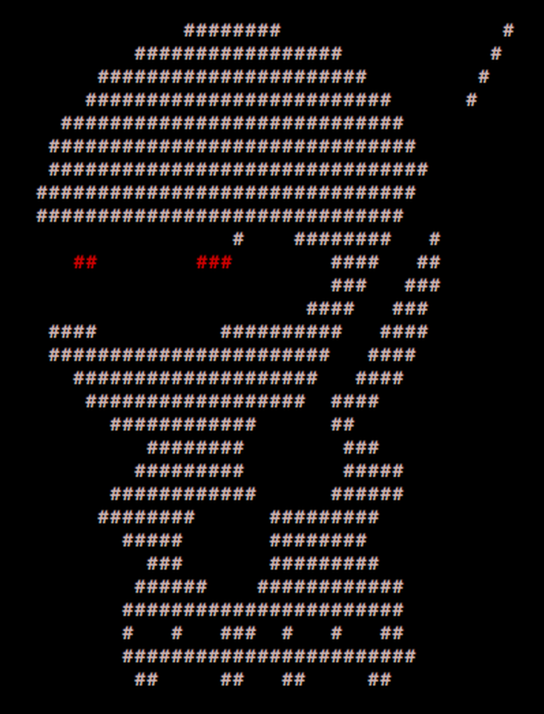
____ _____ _ _
/ ___| ___ __|_ _|_ _| | | _____
\___ \ / _ \/ __|| |/ _` | | |/ / __|
___) | __/ (__ | | (_| | | <\__ \
|____/ \___|\___||_|\__,_|_|_|\_\___/
PER0x53
Technical (in)security talks & hands-on challenges, no bullshit!
Technical (in)security talks & hands-on challenges, no bullshit!

Slide 2
Welcome!
We’re back!
Greetings nerds
Technical (in)security talks & hands-on challenges, no bullshit!

Slide 3
SecTalks PER0x53
Thanks to…
someone for the brews :anyone?:
Spacecubed & Riff!
The committee nidogski & sudosammy
Everyone who contributes!
Technical (in)security talks & hands-on challenges, no bullshit!
Notes:
Have a line up of lightening talks tonight

Slide 4
Speakers PER0x53
“play happy sound for player to enjoy”; Understanding Catastrophic Regex Backtracking
Regular Expressions (RegEx) can be a powerful tool when used the right way, enabling us to quickly and easily find strings that match unique use cases. Whether you’re trying to find IP addresses in firewall logs, ban specific user-agents from your firewall, or hunting through text files for connection strings, there’s often a regex at the core of your implementation. But poorly designed regex can have catastrophic consequences if faced with abnormal data, or intentionally malicious inputs. In this talk we review what regex is, how it can be abused, real-life situations where this has been a problem, and potential solutions.
Conor is an evolutionary mass of atoms whose sole instinct is survival. Works as a Security Analyst who primarily focuses on detection engineering and data analysis – finding data, gathering data, parsing data, employing that data to do wonderful things. He embodies the ‘fuck around and find out’ mindset and applies it to every project.
Technical (in)security talks & hands-on challenges, no bullshit!
Notes:
Conor is an evolutionary mass of atoms whose sole instinct is survival. Works as a Security Analyst who primarily focuses on detection engineering and data analysis – finding data, gathering data, parsing data, employing that data to do wonderful things. He embodies the ‘fuck around and find out’ mindset and applies it to every project.

Slide 5
Speakers PER0x53
Controlling your land: High value internal controls to halt and hinder real world attackers
Once an attacker has compromised the perimeter of your environment, the speed at which they can achieve their objective is dictated by the quality of your internal controls. In this presentation Barnaby will discuss high value internal controls he has seen halt and hinder real world attackers throughout his 7+ years as a Digital Forensics and Incident Response (DFIR) analyst.
Barnaby Skeggs is a digital forensic and incident response (DFIR) analyst who thrives on the technical challenge of investigating and responding to threat actors in an evolving threat landscape. In his role at Mandiant, Barnaby is a technical incident response lead who is responsible for assisting client under cyber-attacks in Asia Pacific and Japan. When not performing incident response, Barnaby works with clients to improve their security operations capabilities through training and Purple Team (attack / defense) exercises.
Technical (in)security talks & hands-on challenges, no bullshit!
Notes:
Conor is an evolutionary mass of atoms whose sole instinct is survival. Works as a Security Analyst who primarily focuses on detection engineering and data analysis – finding data, gathering data, parsing data, employing that data to do wonderful things. He embodies the ‘fuck around and find out’ mindset and applies it to every project.

Slide 6

SecTalks PER0x54
Date: ????
(the randomest day of every month)
Speaker: ??? ← This could be you!
Title: ??? ← This could be anything!
https://goo.gl/4FT53i
Technical (in)security talks & hands-on challenges, no bullshit!

Slide 7



Stay in touch
IRC / SLACK
irc.sectalks.org > #sectalks
and / or ask to be added to the slack
Github
https://github.com/sectalks/sectalks
Twitter
@SecTalks
Technical (in)security talks & hands-on challenges, no bullshit!

Slide 8
BSides Perth 2021
www.bsidesperth.com.au
If you didn’t get a ticket
…make sad noises!
#soldout
#watchthisspace
Technical (in)security talks & hands-on challenges, no bullshit!

Slide 9
Without further ado...
drinks?
~ ~
( o )o)
( o )o )o)
(o( ~~~~~~~~o
( )' ~~~~~~~'
( )|) |-.
o| _ |-. \
o| |_||_) | \ \
| | ||_) | | |
o| | / /
| |." "
| |- '
.========.
Technical (in)security talks & hands-on challenges, no bullshit!

